Slide 1
A Case Study of the Collaboration between the British Library Sound Archive and the Archives and Research Center for Ethnomusicology, New Delhi
Christian Poske, AHRC PhD Student
SOAS, University of London & British Library Sound Archive
British and Irish Sound Archives Conference
Aberystwyth, 16-17 November 2018

Slide 2
Outline
the Archives and Research Center for Ethnomusicology, New Delhi (ARCE)
The Project:
Funding and planning
Realisation
Communication and Outreach
Review Process
Challenges
Outputs and Outcomes

Slide 3
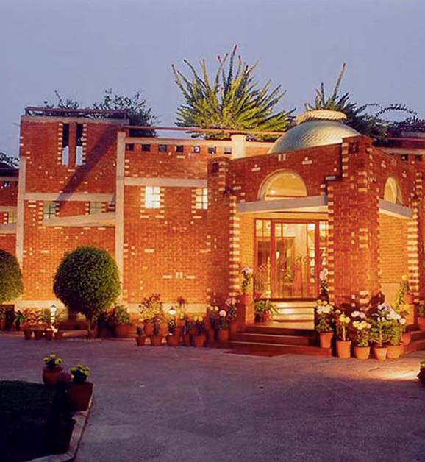
The Archives and Research Centre for Ethnomusicology, New Delhi (ARCE)
Branch of the American Institute of Indian Studies (University of Chicago), member of a consortium of 52 major U.S. universities.
Founded in 1982, the ARCE is an extensive audiovisual archive of the oral traditions and performing arts of India
Serves as a repository for field recordings of South Asian and Western scholars.
Collects commercial recordings and copies of recordings from collectors' private holdings.
Recordings range from Indian classical music to folk and popular genres.
Materials deposited at the ARCE are catalogued and made accessible to interested scholars and institutions.
Selected recordings published and distributed globally by Smithsonian Folkways

Slide 4
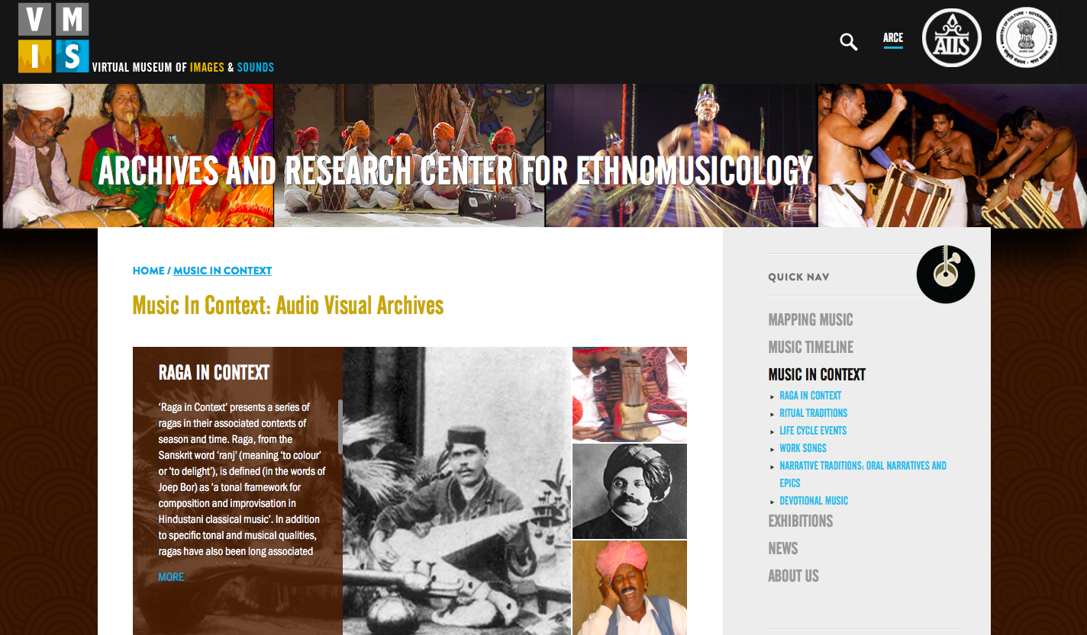

Slide 5
1. Funding and planning
Project funded by the Rutherford Fund, overseen by the Department for Business, Energy and Industrial Strategy (BEIS)
British Library was approached by the BEIS to propose projects with international partners fitting the remit of the Fund
Planning in October-December 2017: - Project planned and workplans for staff drafted by Dr Janet Topp Fargion, Lead Curator of World and Traditional Music at the Sound Archive, and Dr Shubha Chaudhuri, Director of the ARCE. Partner institution involved in planning process from the beginning. - Proposal for project of four months duration drafted and submitted to the BEIS by the Research Development team of the British Library
Project took place in March-June 2018; apart from Project Supervisors, involved: - one Research Fellow: ARCE staff at the British Library Sound Archive for 4 months - one Research Intern at the British Library Sound Archive - one Research Intern at the ARCE

Slide 6
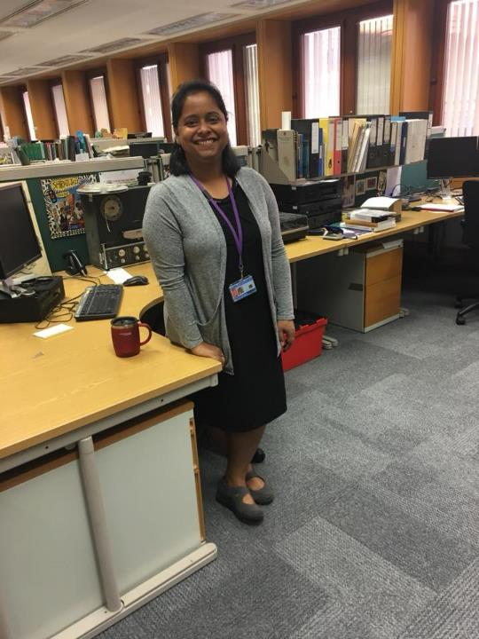
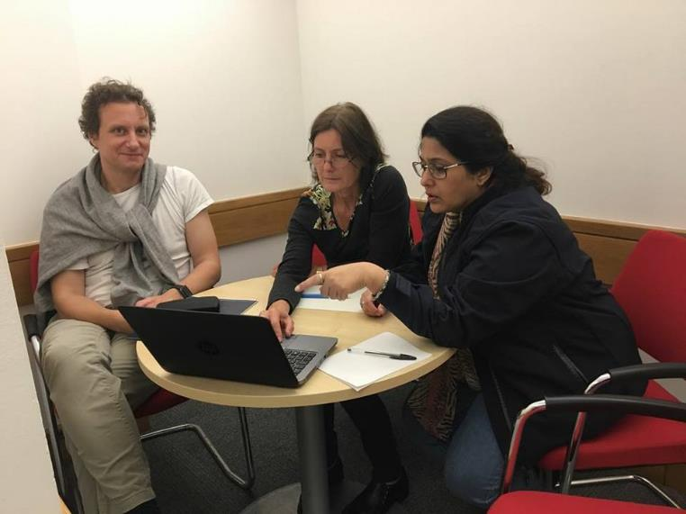
The team at the British Library Sound Archive
Left: Dr Sangeeta Dutta (Research Fellow)
Top: Christian Poske (Sound Archive Research Intern), Dr Janet Topp Fargion (Project Supervisor), Divya Shrivastava (ARCE Research Intern)

Slide 7
2. Realisation
Dr Sangeeta Dutta (Research Fellow)
Research into South Asian audiovisual collections at the Sound Archive
Training and job shadowing to understand workflows at the British Library Sound Archive, particularly those relating to current major digitisation programme Save Our Sounds/ Unlocking Our Sound Heritage (UOSH)
Creation of collection preparation documents for 11 collections of South Asian content, which are to be digitised as part of the UOSH programme
Preparation of collection lists for those collections, including the intellectual groupings of recordings within collections
Cataloguing of British Library World and Traditional Music collections
Networking visits to related institutions and exhibitions in and around London and meetings with scholars, archivists, museum curators, and ethnomusicologists

Slide 8
2. Realisation
Christian Poske (Sound Archive Research Intern) and Divya Shrivastava (ARCE Research Intern)
Research into South Asian audiovisual collections at the Sound Archive
Cataloguing of World and Traditional Music collections at the Sound Archive
Preparation of recordings to be shared between the British Library and ARCE
Exchange of information relating to the collections at the two institutions
Exchange of information around respective cataloguing formats
Development of a model for the classification and cataloguing of musical instruments
Knowledge exchange visits to ARCE and British Library to understand workflows and get training in the archival processes of the other institution

Slide 9
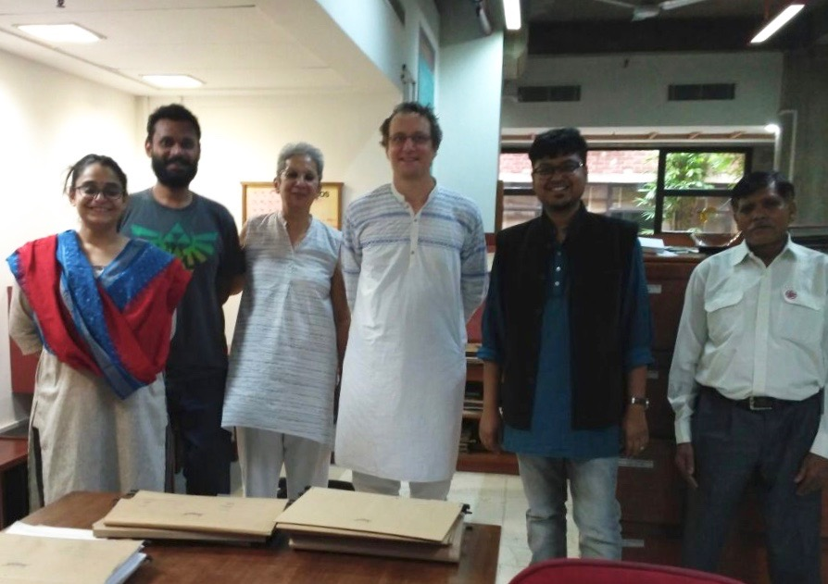

Slide 10
3. Communication and Outreach
Visit to the Museum of Archaeology and Anthropology, University of Cambridge to meet curators, visit the Another India exhibition, and enhance knowledge of relevant collections and curatorial practices
Visit to the Pitt Rivers Museum, Oxford University, to meet curators and enhance knowledge of relevant collections and curatorial practices
Blog post about the project by Dr Sangeeta Dutta published on the British Library Sound & Vision Blog
Recording of the Week blog post about a shared collection by Christian Poske published on the British Library Sound & Vision Blog
Visit to ARCE by Project Supervisor Janet Topp Fargion included presentation on the historical recordings shared with ARCE during this project, and on the Save our Sounds/ Unlocking our Sound Heritage project

Slide 11
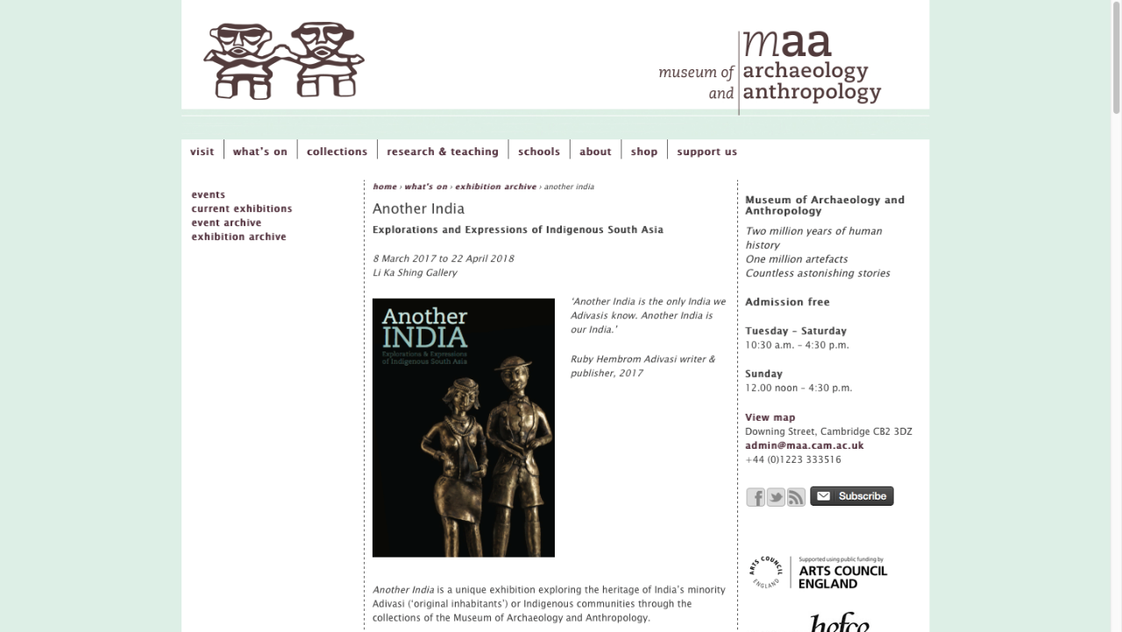

Slide 12
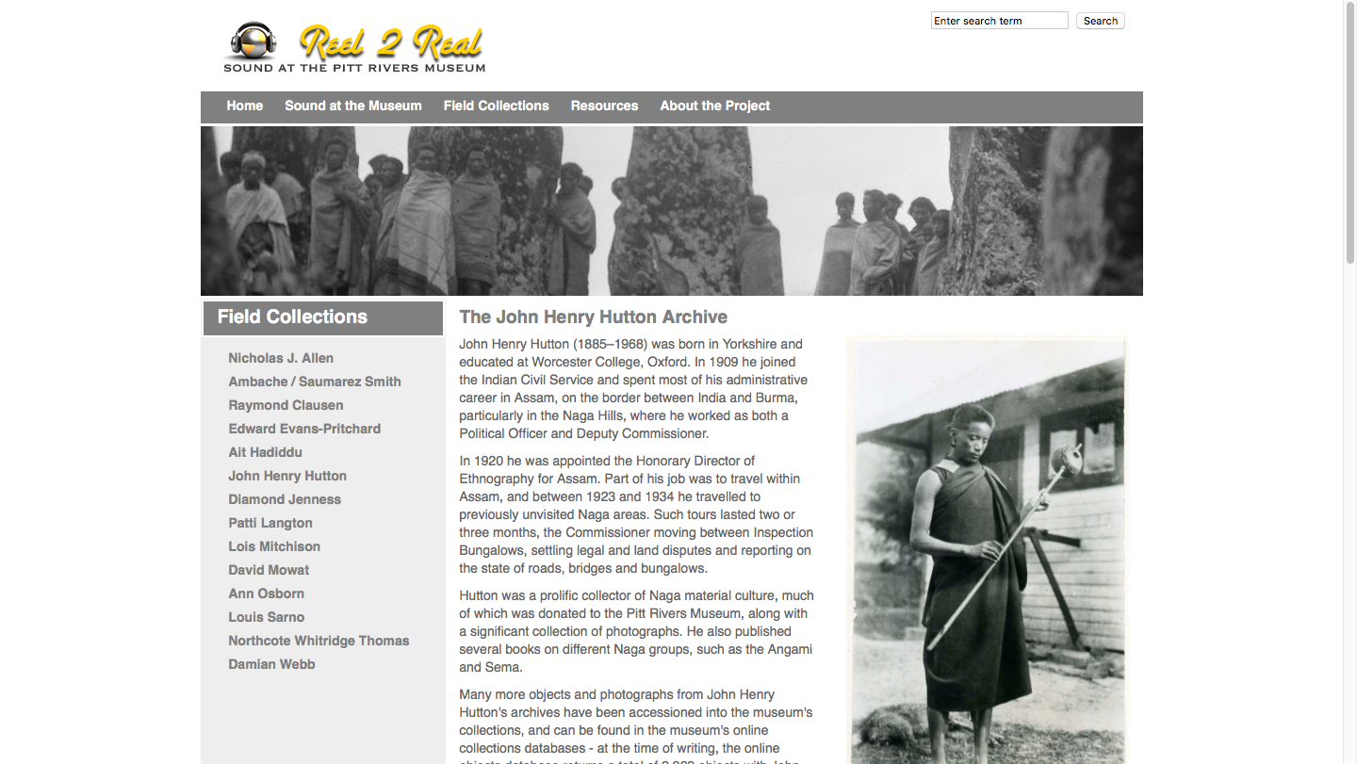

Slide 13
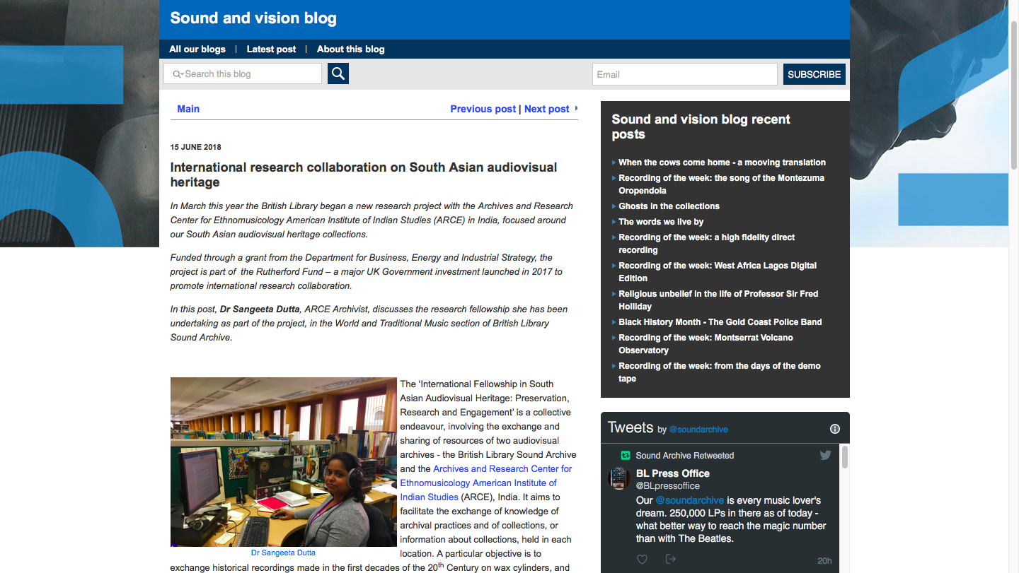

Slide 14
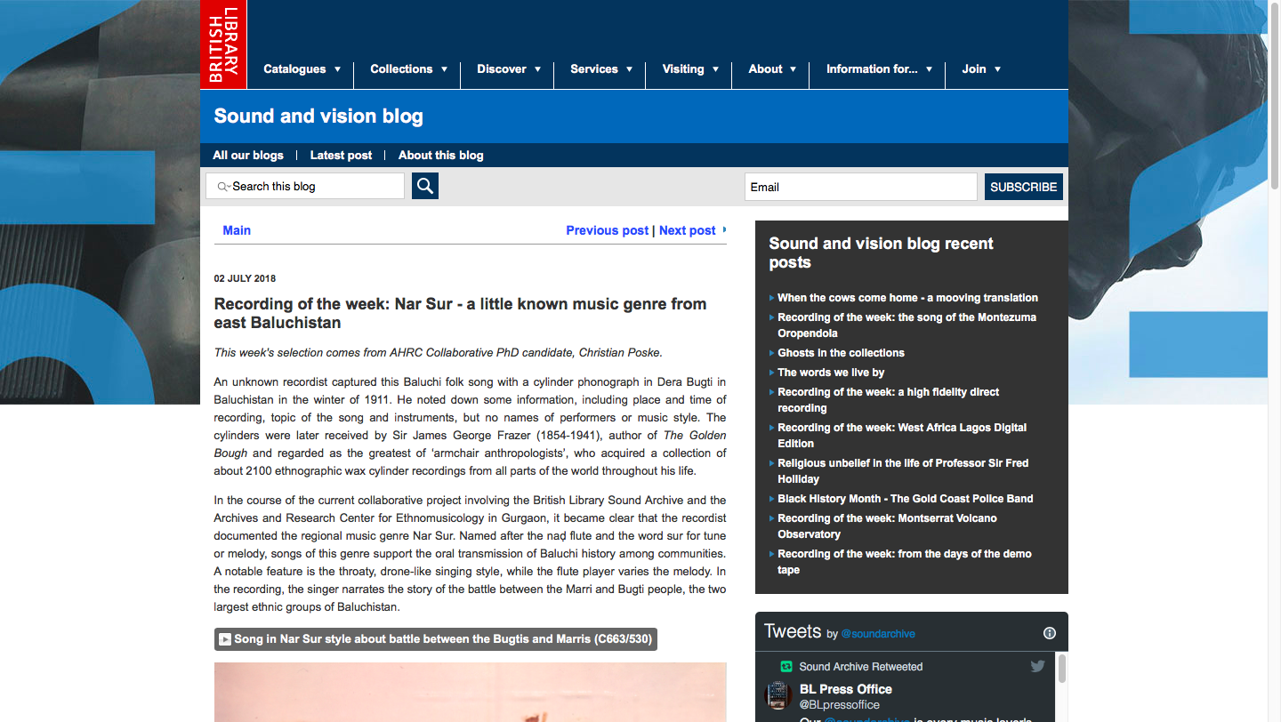

Slide 15
4. Review Process
Internal
Dr Sangeeta Dutta wrote report on the workflow of the Sound Archive’s Unlocking Our Sound Heritage programme for the ARCE
Divya Shrivastava wrote report on visit to the Sound Archive for the ARCE
Christian Poske wrote report on visit to the ARCE for the Sound Archive
External
Dr Janet Topp Fargion and British Library Research Development team wrote progress reports for BEIS, with input from project staff
ARCE Director wrote report for the American Institute of Indian Studies

Slide 16
5. Challenges
Assigning tasks according to relevant staff expertise
One-week exchange visits of Research Interns gave opportunity to understand archival processes and cataloguing systems at the other institution, but too short for deeper engagement with collections
Differing cataloguing systems complicated the assessment and comparison of partly-congruent collections
Emic and etic perspectives on terminology met during cataloguing, e.g. discussions about the terms “tribe” and “ethnic group”
Cultural differences in internal and external communication
Time schedule of exchange visits had to be revised several times during the project
Other unforeseen impediments due to local risks, e.g. theft

Slide 17

6. Outputs and Outcomes
Overviews of current holdings were updated and shared between Sound Archive and ARCE
Enhanced catalogue records and metadata at the Sound Archive
Access copies of three collections of wax cylinder recordings provided to the ARCE
Sharing of documentation of two collections which are held at both Sound Archive and ARCE
ARCE’s musical instrument database enhanced and shared with the Sound Archive as a model for instrument classification in the British Library catalogue Fox Strangways cylinder C72/872, recorded in 1910-11 “Lālishrīta” – Tamil Lullaby

Slide 18



Thank you
Christian Poske
christian.poske@bl.uk
07746798955

